Slide 1

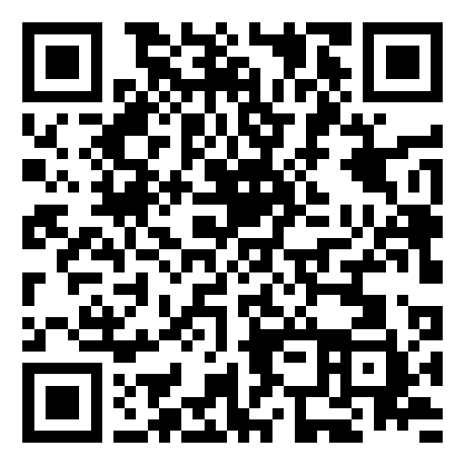
Smart Slides
Make Slides in a flash
How to use Smart Slides

Slide 2
Welcome to Kenya
Discover the Heart of Africa
A Land of Diverse Landscapes and Rich Cultures

Slide 3
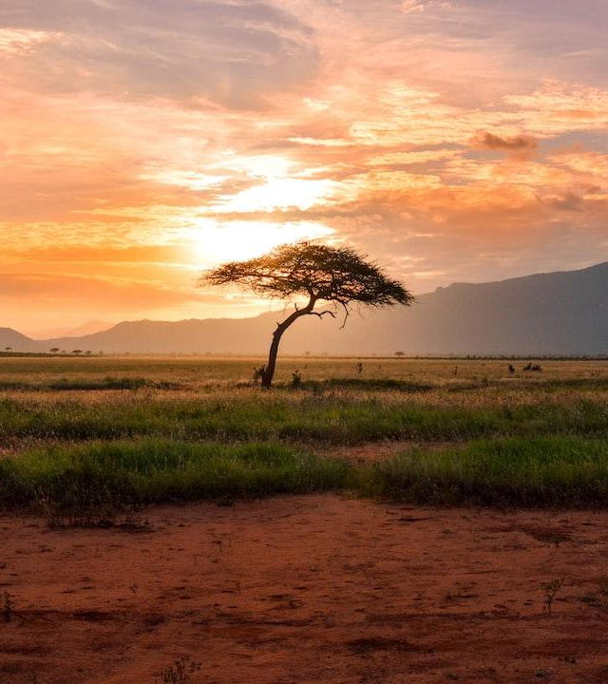
Wildlife and Safaris
Experience the Thrill of the Wild
Home to the Famous Maasai Mara
Photo: tree between green land during golden hour
Photo by Damian Patkowski
Powered by Unsplash

Slide 4
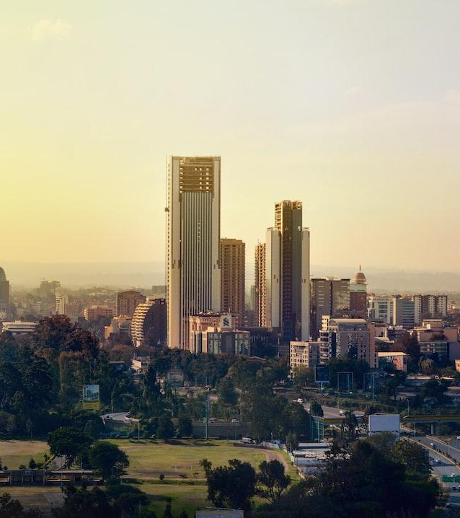
Vibrant Cultures
Explore the Rich Heritage and Traditions
Meet the Warm and Welcoming People
Photo: city skyline under white sky during daytime
Photo by Amani Nation
Powered by Unsplash

Slide 5
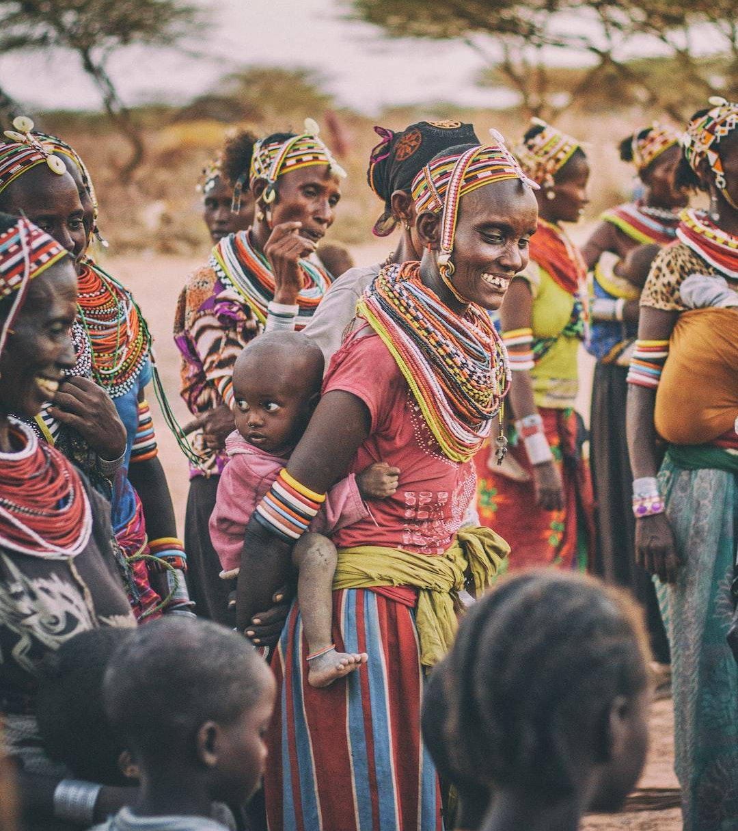
Breathtaking Beaches
Relax on Pristine White Sands
Kenya's Coastal Paradise
Photo: group of people standing on brown ground
Photo by Ian Macharia
Powered by Unsplash

Slide 6
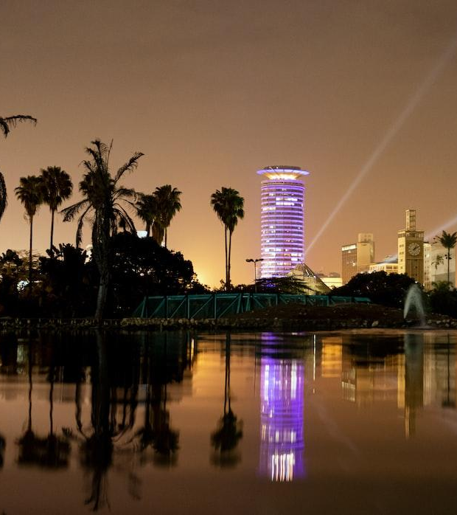
Majestic Mountains
Climb the Iconic Mount Kenya
A Haven for Trekkers and Nature Lovers
Photo: body of water near green trees during night time
Photo by Mustafa Omar
Powered by Unsplash

Slide 7
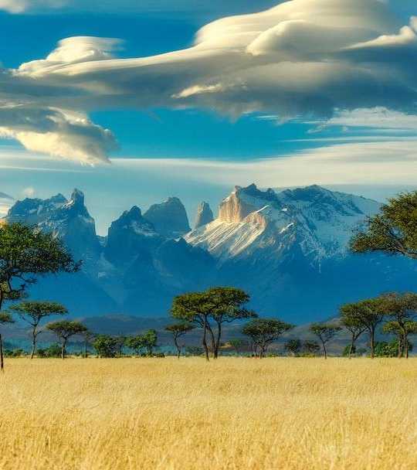
Nairobi: A City of Contrasts
Explore the Bustling Capital
A Blend of Urban and Natural Beauty
Photo: green trees on brown grass field under white clouds and blue sky during daytime
Photo by Thomas Bennie
Powered by Unsplash

Slide 8
Join the Adventure
Kenya Awaits You
Start Your Unforgettable Journey Today

Slide 9
Thanks for using Smart Slides
Learn more about how to use this plugin by visiting https://smartslides.crisp.help/en/article/how-to-use-smart-slides-1w14fiw/
Example Prompts:
Make me a 5 slide presentation about the history of the united states and include charts with images of mountains and rivers
Make me a 5 slide tourist presentation about Norway and lofoten islands with varied layouts and images of the northern lights using
Create a presentation with 5 slides about Sydney with images of Bondi Beach and the Opera House use font size 46 for headings and 36 for content. Use this color #FF5A5F (red) and inlude lots of image slides

